Slide 1
SMALL PRECISION TOOLS
Wedge Auto-Draw Requirements
Small Wire (SW) Wedge Series – 45CK Series – Microwave Bonding Tools
Requirements
DOCUMENT NO.
DATE
PREPARED BY
STATUS
AB16_REQ_Rev0_07232026
2026-23-07
Youssef
Draft

Slide 2
Scope
This document defines the production drawing, customer drawing, and overlay requirements for the AB16 Series – Microwave Bonding Tools
Requirements series, covering both the finished wedge and the Pre-Ground Blank (PGB).Including 45CK, 60CK
SMALL PRECISION TOOLS
Confidential
04

Slide 3
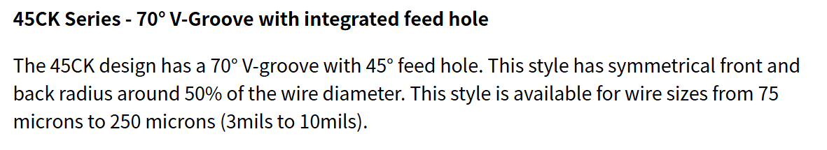
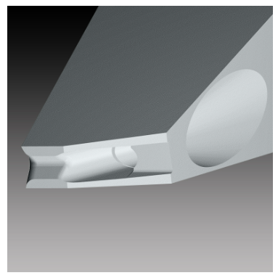
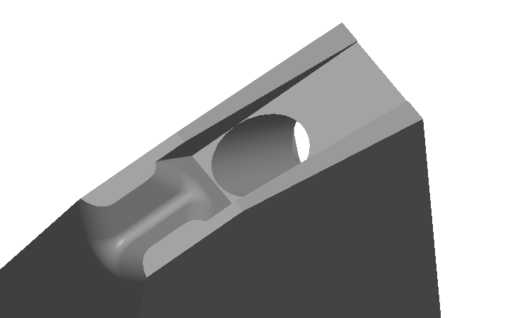
Tool Overview
SMALL PRECISION TOOLS
Confidential
04

Slide 4
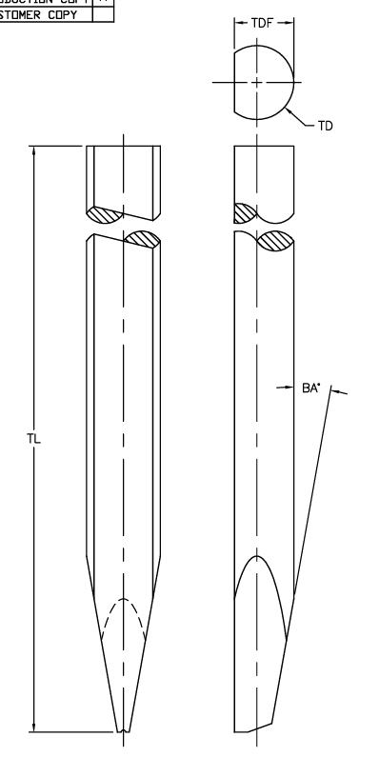
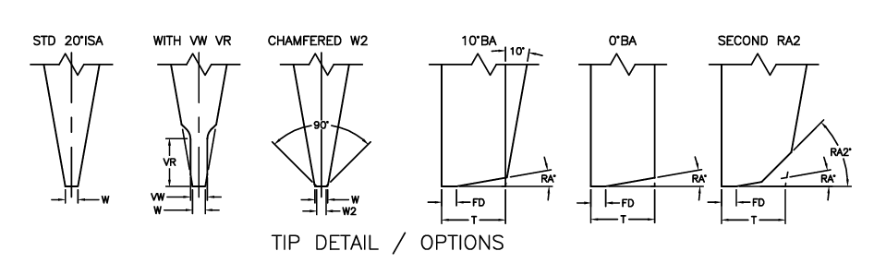
Configuration Options
Shank: SW_STD_Hole with SLB feature
For Tip detail we have STD 20°ISA , WITH VW VR , CHMFERED W2, 10°BA, 0°BA, SECOND RA2
SMALL PRECISION TOOLS
Confidential
04

Slide 5
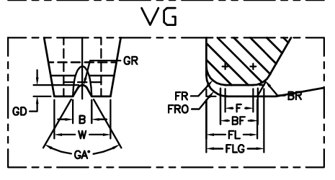
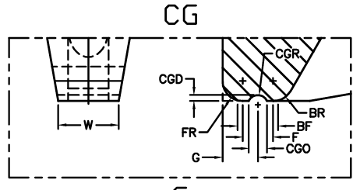
Configuration Options
Foot options: SW_VG, SW_VGCG
Note : For VGVG foot option is it the combination
SMALL PRECISION TOOLS
Confidential
04

Slide 6
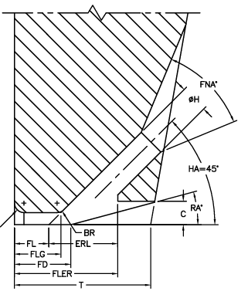
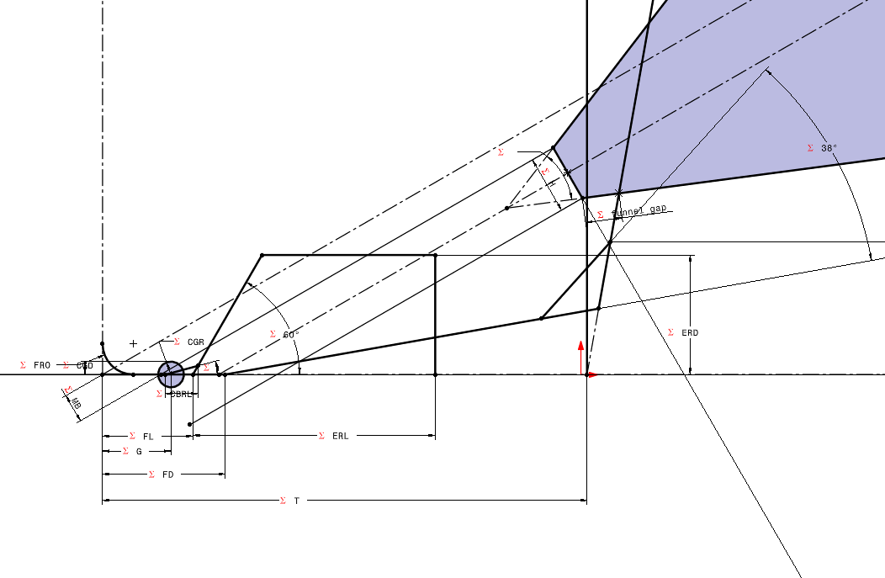
Configuration Options
Notch type: SW_Cavity,
Note : Hole position with Y , tangent to BR and CA Note : We need to add the C cut
SMALL PRECISION TOOLS
Confidential
04

Slide 7
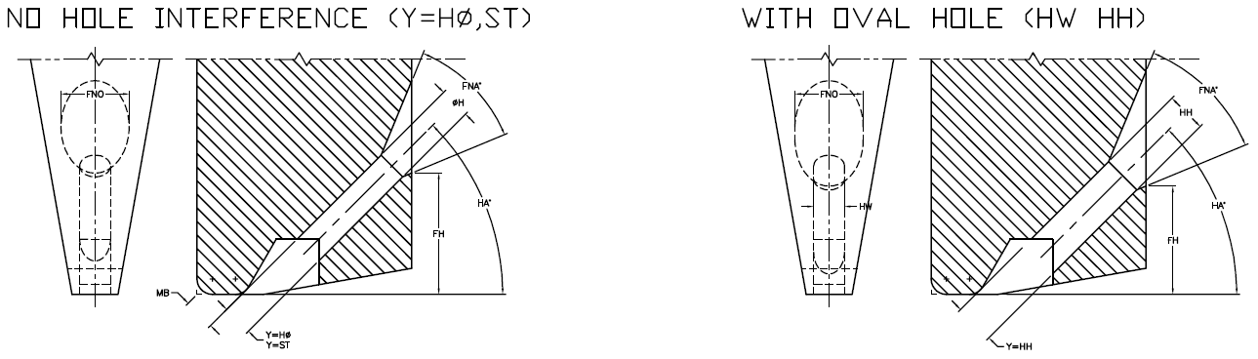
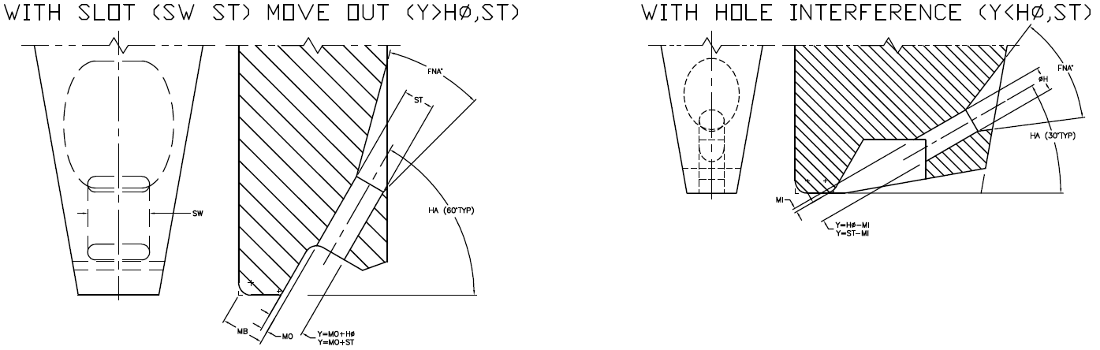
Configuration Options
Feed hole types: STD (Round), Oval, Slot
Note : Y will be used to position the hole
SMALL PRECISION TOOLS
Confidential
04

Slide 8
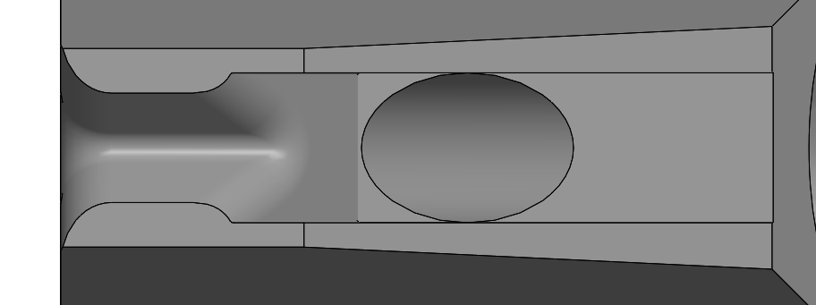

Configuration Options
BR feature: Not specified !
Note : Based on the drawing this is the output of the 3d model !
SMALL PRECISION TOOLS
Confidential
04

Slide 9
Database Requirements
Schema is largely consistent with the COB tool family.
drawing# | partspec# | SG Description 2 | TL_NOM | TL_LTOL | TL_UTOL | TL_COMMENTS | TD_NOM | TD_LTOL | TD_UTOL
22000812 | 116855 | 45CK-125-W-1/16-L-GM | 0.828 | 0.005 | 0.005 |  | 0.0624 | 0.0001 | 0.0001
22000944 | 116848 | 45CK-125-W-3MM-1.00-GM W=350 | 1 | 0.005 | 0.005 |  | 0.118 | 0.0001 | 0.0001
22000944 | 116850 | 45CK-125-W-3MM-1.00-GM W=350 DWG:10222 | 1 | 0.005 | 0.005 |  | 0.118 | 0.0001 | 0.0001
2020162 | 141275 | 45CK-200-W-1/16-3/4-GM | 0.828 | 0.005 | 0.005 |  | 0.0624 | 0.0001 | 0.0001
22000945 | 133401 | 45CK-200-W-3MM-1.00-GM W=440 | 1 | 0.005 | 0.005 |  | 0.118 | 0.0001 | 0.0001
22000945 | 129939 | 45CK-200-W-3MM-1.00-GM W=440 DWG:10222 | 1 | 0.005 | 0.005 |  | 0.118 | 0.0001 | 0.0001
22000846 | 116849 | 45CK-250-W-3MM-1.00-GM | 1 | 0.005 | 0.005 |  | 0.118 | 0.0001 | 0.0001
Note : We may need to add the fields like Wedge type; Foot type; etc. Note : We will need to add some rules of data handling !
SMALL PRECISION TOOLS
Confidential
04

Slide 10
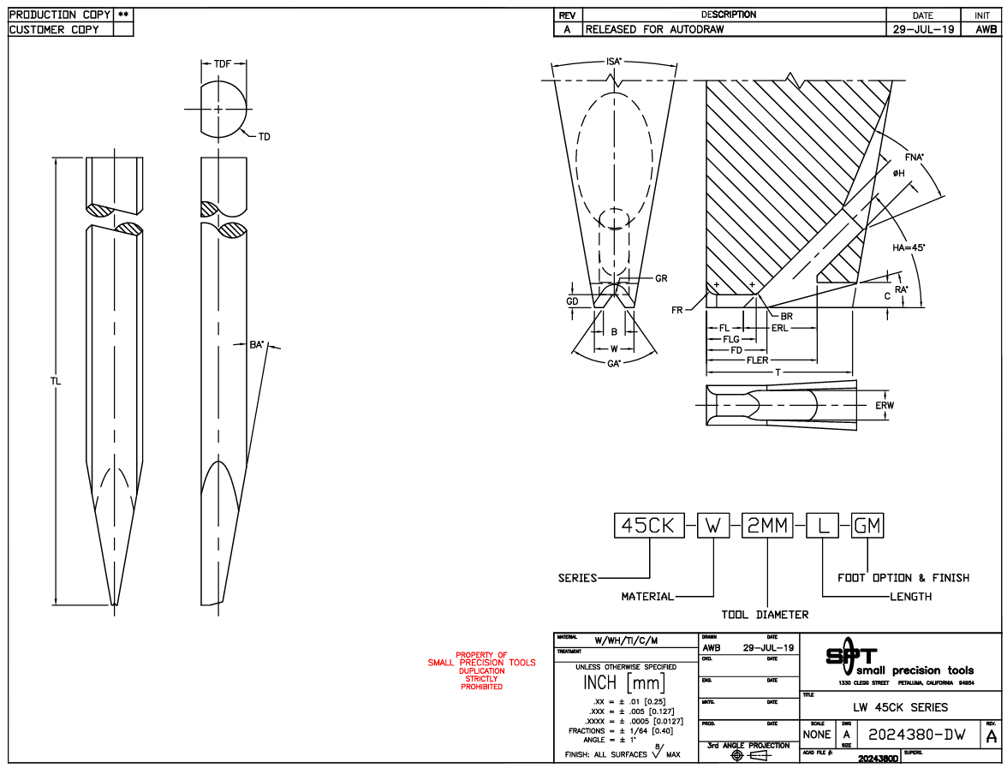
Customer Drawing Requirements
For customer drawing we will replicate as the same provided, following the same step as COB
Front, Right & Top Views
Detail & Section Views
Dimensions Tables
Note : I wil need the customer drawing sample
SMALL PRECISION TOOLS
Confidential
04

Slide 11
Production Drawing Requirements
For customer drawing we will replicate as the same provided, following the same step as COB
Front, Right & Top Views
Detail & Section Views
Dimensions Tables
Add all dimensions and parameters to views
Note : The production drawing will follow the same as sample provided
SMALL PRECISION TOOLS
Confidential
04

Slide 12
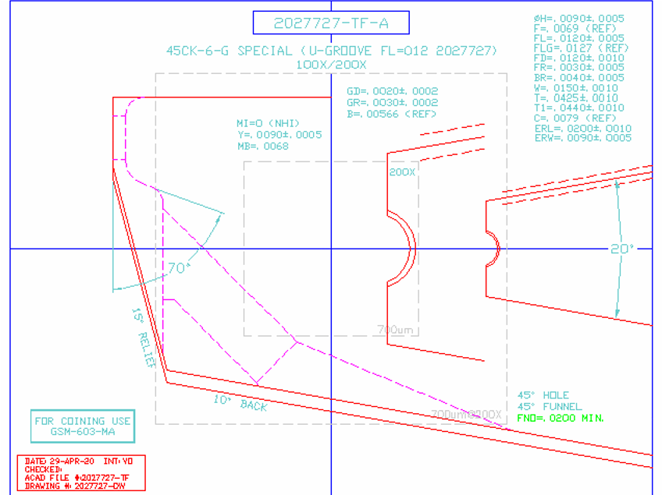
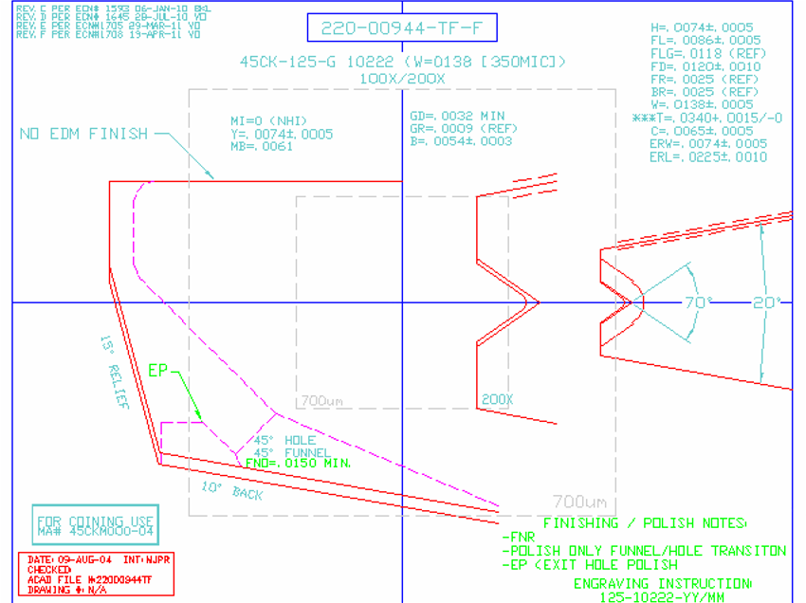
Overlay Requirements: Finish Wedge
Like COB overlay, with different tolerance zone construction. .
Note : Scaling the view the same way as COB, The T dimension start from TDF Note : Only add two views to the overlays Note : No need to all the annotations
SMALL PRECISION TOOLS
Confidential
04

Slide 13
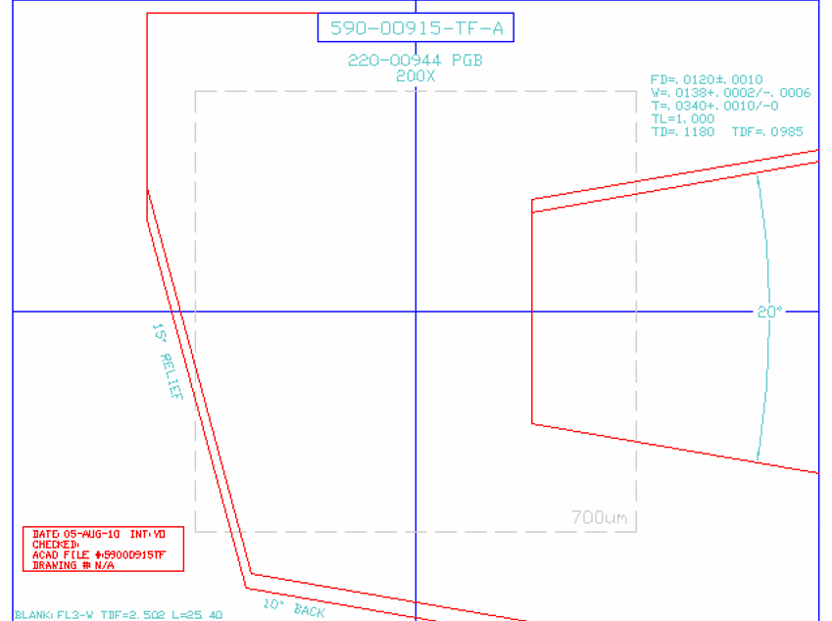
Overlay Requirements: PGB
Remains unchanged from the standard wedge overlay used across all tool families. Feed Hole added
Note : The PGB may have the VR/VW version !
SMALL PRECISION TOOLS
Confidential
04

